Slide 1


Design and Implementation of a Smart Irrigation System for Precision Agriculture
Instructors Wayne Okello wayne.okello@netlabsug.org David Kateeba katsdavid72@gmail.com
Notes:
1

Slide 2
Introduction
what’s smart irrigation system project
What’s importance?, why was it created?,
Notes:
Presenter’s notes; The Smart Irrigation System project seeks to address the critical challenges of water scarcity, inefficient irrigation practices, and escalating operational costs faced by modern farming operations. By harnessing the power of IoT and data-driven decision-making, the Smart Irrigation System strives to optimize water usage, enhance crop yield, and promote sustainable agricultural practices.

Slide 3
Objectives of the Project
The primary objective of this project is to develop an advanced Smart Irrigation System :
To optimizes water usage
To enhances crop yield
To reduces operational costs
To provide data-driven insights
To control mechanisms for sustainable and efficient irrigation practices in precision agriculture.
Notes:
Presenter’s notes: This type of system can greatly benefit modern agriculture by integrating technology and data analysis into irrigation practices. Here's how each of the objectives contributes to the overall success of the project:
Optimizing Water Usage: Smart Irrigation Systems use sensors to monitor soil moisture levels, weather conditions, and other relevant factors in real-time. By analyzing this data, the system can determine the exact amount of water needed for the crops. This prevents overwatering and minimizes water wastage, thus promoting more efficient water usage.
Enhancing Crop Yield: A well-managed irrigation system ensures that crops receive the right amount of water at the right time, promoting healthy growth and maximizing yield. By tailoring irrigation practices to the specific needs of each crop, you can create an environment conducive to optimal growth and increased production.
Reducing Operational Costs: With precise water delivery based on real-time data, you can reduce the costs associated with excessive water usage and energy consumption. Additionally, by automating various irrigation processes, labor costs can also be minimized.
Providing Data-Driven Insights: The system's data collection and analysis capabilities can provide valuable insights into how different crops respond to varying irrigation strategies. This information can guide farmers in making informed decisions about irrigation schedules, water allocation, and overall crop management.
Control Mechanisms for Sustainability: Sustainable agriculture is crucial for the long-term health of the environment and the industry. Smart Irrigation Systems can be programmed to adhere to sustainable practices, such as using water efficiently, avoiding over-irrigation, and reducing the risk of soil erosion.
Efficient Irrigation Practices in Precision Agriculture: Precision agriculture involves using technology to fine-tune agricultural practices. Smart Irrigation Systems align perfectly with this approach by precisely tailoring irrigation to specific areas of a field based on variations in soil type, topography, and crop type. This level of precision ensures that every part of the field receives the appropriate amount of water.

Slide 4
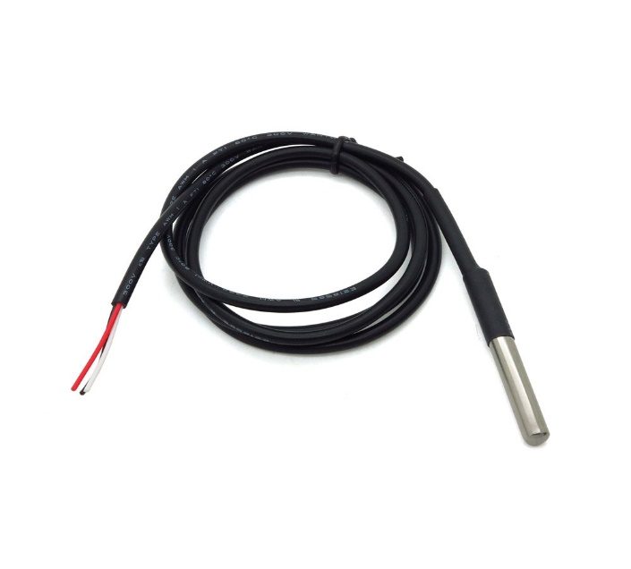
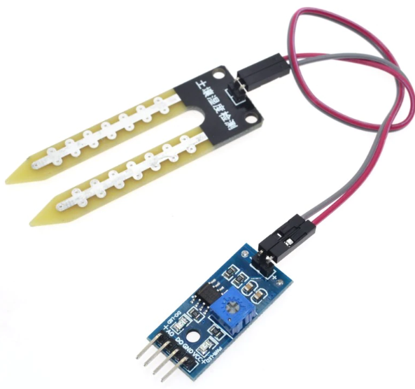
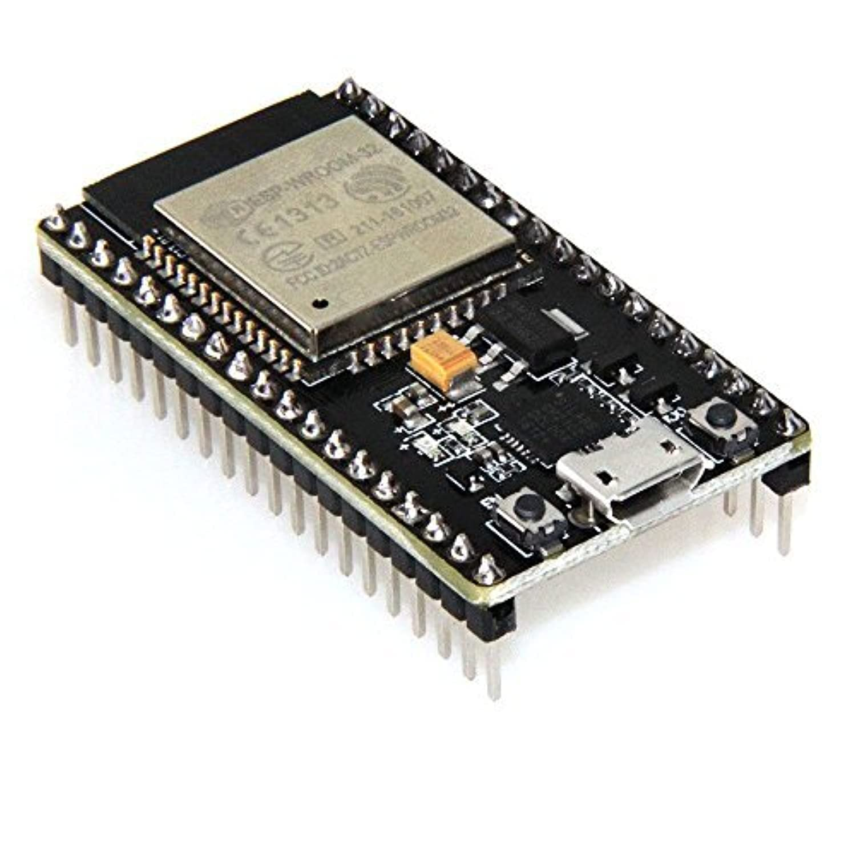
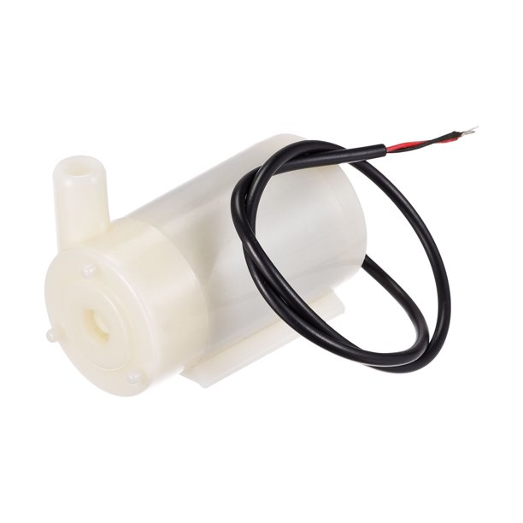
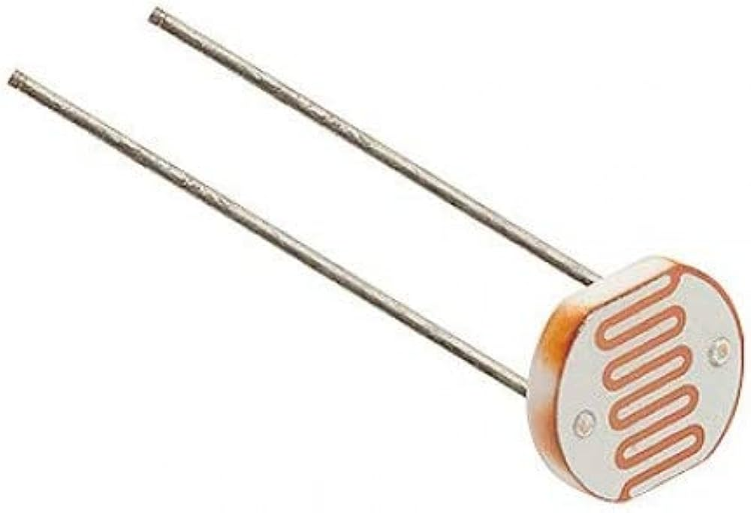
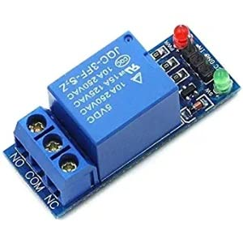
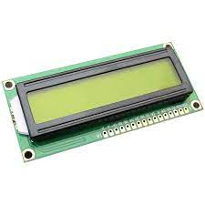
System Design
Soil moisture sensor
submersible digital temperature sensor
Water pump
Light dependent resistor
Relay
ESP32 board
LCD
Notes:
Why these Sensors:
Soil Moisture Sensor: Placed at strategic points in the soil, this sensor measure the moisture content. This is essential for determining the water needs of the plants accurately helping us answer the question: Is the soil dry enough to warrant irrigation?
Submersible Temperature Sensor: Submerged in the soil, it provide real-time temperature readings which is crucial for determining plant health and growth patterns. By factoring in soil temperature, our smart irrigation system ensures that plants receive water at the appropriate temperature for optimal growth.
LDR (Light-Dependent Resistor): This sensor measures ambient light levels. It aids in assessing sunlight exposure, influencing irrigation schedules by accounting for varying light conditions.

Slide 5
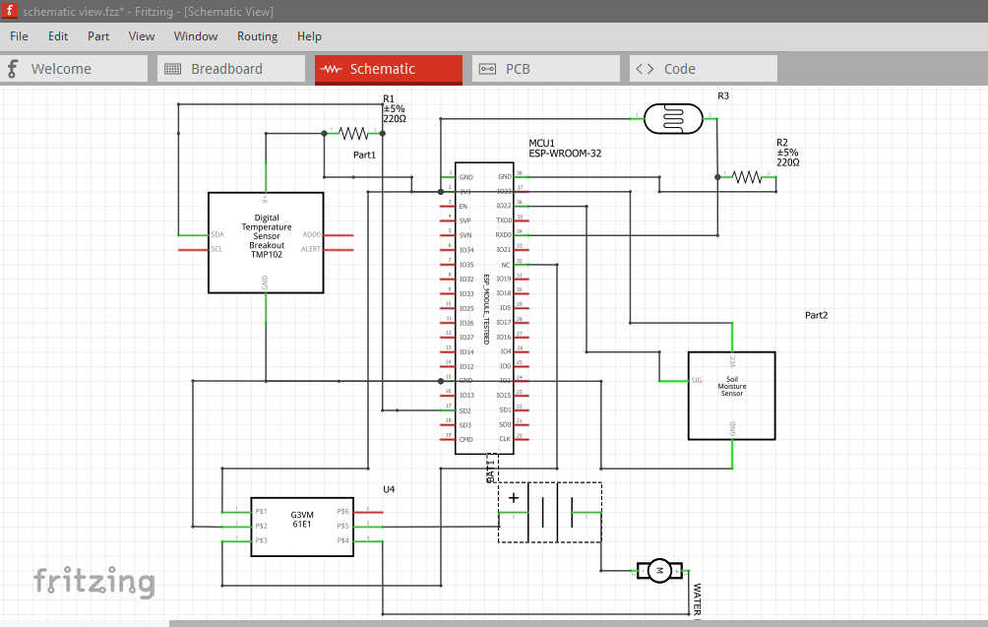
Schematic view

Slide 6
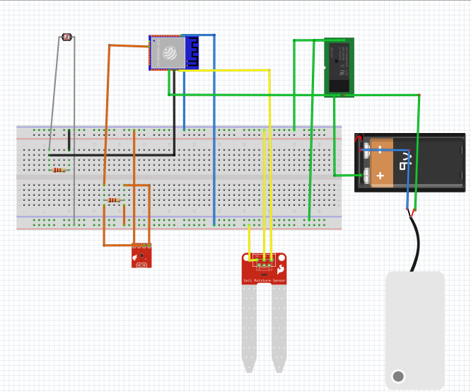
Breadboard connection

Slide 7
Embedded system operation
https://github.com/Vinald/Netlabs-Project/blob/main/Arduino/Code/A5/3/3.ino
Notes:
This code is an example of an implementation for an advanced Smart Irrigation System using an ESP32 microcontroller. It combines various sensors, communication protocols, and cloud platforms to optimize irrigation practices. Let's break down the code and explain each part:
1. Libraries and Dependencies:
The code includes several libraries to facilitate different functionalities:
- `LiquidCrystal_I2C`: For interfacing with a character LCD screen via I2C.
- `Arduino`, `Wire`, `OneWire`, `DallasTemperature`: Required for hardware communication and temperature sensor.
- `ThingSpeak`: Used for sending sensor data to the ThingSpeak cloud platform.
- `WiFi`, `FirebaseESP32`: Used for connecting to Wi-Fi and Firebase.
- `Bluetooth Serial`: For Bluetooth communication with other devices.
- `my_new_model`: A custom library, presumably containing a machine learning model.
- `vector`: Used for managing dynamic arrays.
- `TimeLib`: For working with timestamps.
2. Constant and Variable Definitions:
The code defines various constants and variables, including pins for sensors and actuators, thresholds for sensor readings, Wi-Fi credentials, API keys for cloud services, and more.
3. Sensor and Component Initialization:
The `setup Sensors()` function sets up the pins and configurations for sensors, the relay pin, the LCD, and the DS18B20 temperature sensor.
4. Wi-Fi Connection:
The `connectWiFi()` function connects the ESP32 to a Wi-Fi network using the provided SSID and password.
5. Sending Data to Cloud Platforms:
The `sendDataToThingSpeak()` and `sendDataToFirebase()` functions send sensor readings (soil moisture, temperature, LDR) along with other relevant information (such as timestamp and pump status) to ThingSpeak and Firebase, respectively.
6. Displaying Sensor Readings:
The `displaySensorReadings()` function updates and displays sensor readings on an LCD screen.
7. Label Encoding for Crop Type:
The `labelEncodeCropType()` function converts a string crop type into an integer label. This is useful for machine learning prediction.
8. Predicting Irrigation Needs:
The `predictIrrigation()` function uses the machine learning model to predict irrigation needs based on crop type, crop days, soil moisture, and temperature.
9. Handling Bluetooth Commands:
The `handleBluetoothCommands()` function listens for commands (0 or 1) sent via Bluetooth. It controls the pump's status accordingly.
10. Pump Control Logic:
The `controlPump()` function determines whether to turn the pump on or off based on various conditions, including temperature, moisture levels, and predicted irrigation needs.
11. Formatted Timestamp Generation:
The `getFormattedTimestamp()` function converts a UNIX timestamp into a formatted date and time string.
12. Setup and Loop:
The `setup()` function initializes the system, including sensors, Wi-Fi, cloud services, and Bluetooth. The `loop()` function reads sensor values, displays them, predicts irrigation needs, handles Bluetooth commands, and controls the pump accordingly.
Certainly, I'll break down what's happening within the `setup()` and `loop()` functions of the provided code:
`setup() Function`:
Serial Communication Initialization: - Serial. Begin(9600): Initializes serial communication at a baud rate of 9600, allowing for communication with the serial monitor for debugging purposes.
Sensor and Component Setup:- setupSensors(): Calls the setupSensors()` function to set up pins and configurations for sensors, the relay pin, the LCD, and the DS18B20 temperature sensor.
Wi-Fi Connection: - connectWiFi(): Calls the `connectWiFi()` function to establish a Wi-Fi connection using the provided SSID and password.
Cloud Platforms Initialization: - `ThingSpeak.begin(client): Initializes the ThingSpeak cloud platform for sending data.
Firebase.begin(FIREBASE_HOST, FIREBASE_AUTH);`: Initializes the Firebase cloud platform with the provided host URL and authentication key.
Bluetooth Initialization:- `SerialBT.begin("ESP32-Bluetooth");`: Initializes Bluetooth serial communication with the name "ESP32-Bluetooth" for pairing with other devices.
` loop() Function`:
1. **Sensor Readings:**
- `int ldrValue = analogRead( LDRPin);`: Reads the analog value from the LDR (Light Dependent Resistor) sensor.
- `int soilMoistureVa - `int mappedSoilMoistureValue = map(soilMoistureValue, 0, 1023, 0, 250);`: Maps the soil moisture value to a range of 0 to 250.lue = analogRead( soilMoisturePin);`: Reads the analog value from the soil moisture sensor.
2. **Temperature Reading:**
- `DS18B20.requestTemperatures();`: Requests temperature readings from the DS18B20 temperature sensor.
- `float temperatureC = DS18B20.getTempCByIndex(0);`: Retrieves the temperature in degrees Celsius from the sensor.
3. **Display Sensor Readings:**
- `displaySensorReadings( mappedSoilMoistureValue, temperatureC, ldrValue);`: Calls the `displaySensorReadings()` function to display the sensor readings on the LCD.
4. **Night Time Check:**
- Checks if it's nighttime by comparing the LDR value to a threshold. If it's nighttime, sensor data is sent to the cloud platforms without performing irrigation-related actions.
5. **Predicting and Irrigation Control:**
- If it's not nighttime, the code proceeds to predict irrigation needs based on the crop type, mapped soil moisture, and temperature using the `predictIrrigation()` function.
- `handleBluetoothCommands();`: Checks for Bluetooth commands and controls the pump status accordingly.
- `controlPump(prediction, temperatureC, mappedSoilMoistureValue);`: Calls the `controlPump()` function to manage the pump status based on various conditions.
6. **Sending Data to Cloud Platforms:**
- `sendDataToThingSpeak(mappedSoilMoistureValue, temperatureC, ldrValue);`: Sends sensor data to ThingSpeak.
- `sendDataToFirebase(mappedSoilMoistureValue, temperatureC, ldrValue);`: Sends sensor data to Firebase.
The `loop()` function continuously loops, reading sensor data, making predictions, controlling the pump, and sending data to the cloud platforms. This loop ensures that the irrigation system operates based on real-time sensor data and predictive models.
This code showcases the integration of various components and functionalities required for an advanced Smart Irrigation System. Depending on your specific requirements and hardware, you may need to tailor and expand this code to fit your project's needs.

Slide 8
Challenges and Solutions
Problems:
Sensor Calibration Issue
Water Pump Not Activating
Display Showing Incorrect Data
Light Intensity Irrigation Not Functioning
Temperature Reading Inconsistent
Water Pump Continuously Running
No Display Output
Erratic System Behavior
Notes:
1.Problem: Sensor Calibration Issue
Cause: Soil moisture sensor might need calibration.
Solution: Recalibrate the sensor according to provided guidelines.
2.Problem: Water Pump Not Activating
Cause: Moisture threshold set too high.
Solution: Adjust threshold settings in the code.
3.Problem: Display Showing Incorrect Data
Cause: Code processing data incorrectly for display.
Solution: Review and correct data processing code.
4.Problem: Light Intensity Irrigation Not Functioning
Cause: Incorrect light intensity threshold configuration.
Solution: Configure light intensity threshold in code.
5.Problem: Temperature Reading Inconsistent
Cause: Wiring issues causing inconsistent temperature readings.
Solution: Check and secure wiring connections.
6.Problem: Water Pump Continuously Running
Cause: Faulty logic in the code.
Solution: Review and adjust pump control logic.
7.Problem: No Display Output
Cause: Incorrect LCD display initialization.
Solution: Ensure proper LCD display initialization in setup code.
8.Problem: Erratic System Behavior
Cause: Electrical interference from nearby devices.
Solution: Minimize interference sources, maintain a clean setup.

Slide 9
PART 2: Machine Learning
https://github.com/Vinald/Netlabs-Project/blob/main/Machine%20Learning/ML%202/Capstone%20project.ipynb
Notes:
Machine learning aims to answer business questions, identify and analyze trends, and assist in problem solving by identifying patterns in your data and then making predictions based on these frequently complicated results. Our research question was to predict if there is need for irrigation or not. These predictions were to provide instruction to the pump on the embedded system.

Slide 10
Conclusion
MACHINE LEARNING
Notes:
CONCLUSION:Machine learning's integration into agriculture heralds a new era of smart farming. By leveraging data analysis, it optimizes irrigation for efficient water use and maximizes yield through predictive insights. This technology detects diseases early, enhancing crop health. With a sustainability focus, it conserves water and encourages eco-friendly practices. Its adaptive algorithms continuously learn from real-time data, fostering innovation. Ultimately, machine learning empowers agriculture, leading to smarter, more sustainable farming practices for enhanced productivity and environmental consciousness.

Slide 11
System Operation
1. Data Analysis and Machine Learning:
Data Processing: The central controller receives data from the sensors, including soil moisture, temperature, and light conditions. The collected data is then fed into a machine learning model embedded within the microcontroller.
Machine Learning Model: The machine learning model has been trained on historical data to recognize patterns, correlations, and complex relationships between sensor inputs and optimal irrigation practices. It identifies nuanced insights that traditional threshold-based systems might miss.

Slide 12
System Operation
2. Real-Time Adjustment and Adaptive Irrigation:
Informed Frequency and Duration: The machine learning model, in conjunction with the central controller, determines whether irrigation is needed. It calculates irrigation frequency and duration, considering current sensor data and leveraging insights gained from historical data.
Adaptive Response: The system's adaptive nature comes to the forefront. The machine learning model adapts irrigation plans based on real-time conditions. If sudden temperature changes are detected, the model's understanding of plant stress and evaporation rates allows it to adjust irrigation frequency accordingly.

Slide 13
Data Analysis: Leveraging Machine Learning for Optimized Irrigation
Harnessing Data for Efficiency:
Sensors collect real-time soil moisture, temperature, and light data.
Central controller processes data and utilizes machine learning insights.
Data-Driven Insights:
Dataset informs machine learning model about plant responses.
Patterns in historical data are recognized, aiding decision-making.
Efficiency through Machine Learning:
Model predicts optimal moisture levels based on data.
Informed irrigation decisions mitigate over/under-watering.
Tailored Growth Strategies:
Machine learning enables customized irrigation plans.
Plants receive water based on individual needs and environmental factors.

Slide 14
Communication and Connectivity
Bluetooth & Web Integration: Seamlessly connect your smart irrigation system through Bluetooth and a user-friendly web application.
Microcontroller Hub: The microcontroller serves as the central hub, managing Bluetooth communication and interfacing with the web application.
Sensor-Controller Flow: Sensors collect data; microcontroller centralizes it, facilitating real-time insights and remote control.

Slide 15
Communication and Connectivity
Advantages & Usage
Effortless Interaction: Bluetooth offers quick adjustments, while the web application provides detailed analysis and remote access.
User-Centric: Dual interfaces accommodate varying preferences for real-time control and historical insights.
Practical Scenario: User receives a soil moisture alert via the web application. They access real-time data remotely using Bluetooth, optimizing irrigation based on historical trends.

Slide 16
Benefits
1. Water Conservation:
Precise Irrigation: Machine learning optimizes water distribution, targeting specific areas for minimal wastage.
Adaptive Control: Microcontroller responds to real-time data, preventing overwatering and promoting efficient usage.
2. Reduced Costs:
Lower Water Bills: Machine learning-driven irrigation reduces water consumption, translating to cost savings.
Maintenance Efficiency: Timely notifications via the web app and microcontroller insights minimize maintenance expenses.
3. Improved Plant Health:
Optimal Conditions: Machine learning-based decisions maintain the perfect moisture balance for thriving plant health.
Prevent Stress: Adaptive strategies avert under watering and plant stress, ensuring robust growth

Slide 17
Benefits
4. User-Friendly:
Intuitive Interface: The web application offers effortless scheduling, remote control, and insightful data visualization.
Time Savings: Users manage irrigation from anywhere via the web app, saving valuable time and effort.
5. Environmental Stewardship:
Sustainable Resource Use: Machine learning-driven efficiency aligns with eco-conscious practices, conserving water and energy.
Carbon Footprint Reduction: Reduced resource consumption contributes to a greener environment and a smaller carbon footprint.
6. Practical Realization:
Example Usage: A user remotely adjusts the irrigation schedule through the web app, leveraging machine learning insights to conserve water.
Holistic Benefits: The combined power of machine learning, microcontroller, and web application delivers water savings, cost reduction, plant health enhancement, and user convenience within a single integrated system.

Slide 18
Enhancements
1. Integration of Weather Forecast:
Potential Enhancement: Incorporating real-time weather forecast data for more precise irrigation decisions.
Benefits: Prevent unnecessary irrigation if rain is expected, further optimizing water usage.
2. AI-Driven Irrigation:
Future Prospect: Integration of artificial intelligence algorithms for enhanced decision-making.
Advantages: AI adapts to complex data patterns, fine-tuning irrigation schedules for optimal plant health.
3. Soil Nutrient Monitoring:
Possible Feature: Adding sensors to monitor soil nutrient levels, enriching data-driven insights.
Benefits: Tailored irrigation strategies based on nutrient content for healthier plant growth.

Slide 19
Enhancements
4. Sensor Fusion Technology:
Emerging Trend: Utilizing sensor fusion for cross-referencing data from multiple sensors.
Advantages: More comprehensive and accurate understanding of soil conditions.
5. Adaptive Learning:
AI Expansion: AI-driven system learns from past irrigation decisions, refining strategies over time.
Implications: Constant improvement in efficiency, customization, and water conservation.
6. IoT Expansion:
Smart Integration: Extending the system's reach through more connected devices and locations.
Benefits: Centralized control over larger areas, promoting sustainable water management.

Slide 20
Conclusion

